Slide 1




(Pseudo)Scalar Fields in the Early Universe
Nick E. Mavromatos
King’s College London &
CERN/PH-TH
London Centre
for Terauniverse
Studies (LCTS)
AdV 267352
IRAP Ph D School, Nice
September 2-21 2013

Slide 2
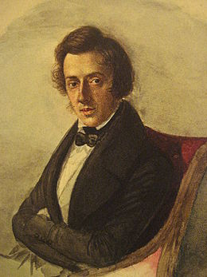

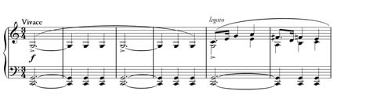
F. Chopin, Mazurca in C Major, Op. 56, No 2
The middle section is filled with two kinds of kujawiak. In the first, a simple melody cast into the bass seems to sound with a male voice. In the second, subtly embellished, one hears a ‘female’ voice…
…. The two melodies complement each other perfectly. In their immediate wake,
Chopin introduces a scalar melody, given in the form of a canon, which functions here almost like a ‘foreign body’. But that is, of course, merely a first impression. Its real function is to allow the closing return of the rhythms of the initial mazurka to sound like deliverance.
http://en.chopin.nifc.pl/chopin/composition/detail/id/249

Slide 3
OUTLINE
Motivation: There is dominance of matter over antimatter
Higgs scalar gives masses to Standard Model
(SM) particles except neutrinos
Seesaw mechanism can account for smallness
of mass of active neutrino species through right-
handed neutrinos in extensions of SM
In the talk: discuss role of pseudoscalar fields as
responsible for both right-handed Majorana
neutrino masses beyond seesaw and
matter-antimatter asymmetry in the Universe with
no need to adjust extra amount of CP Violation
Role of (heavy) Majorana Right-handed Neutrinos
In Leptogenesis/Baryogenesis: extra CP Violation & Dark Matter

Slide 4
SCALAR FIELDS IN EARLY UNIVERSE
Scalar Fields in Early Universe: Plenty of them in extended
particle physics models:
inflaton(s), dilaton, axions,
moduli ….Various effects…

Slide 5
OUTLINE
Scalar Fields in Early Universe: Plenty of them in extended
particle physics models:
inflaton(s), dilaton, axions,
moduli ….Various effects…
Concentrate on:
String-Inspired Models and Torsionful Geometries:
Torsionful Geometries of early universe due to a Kalb-Ramond Pseudoscalar (KR ``axion’’):

Slide 6
OUTLINE
Scalar Fields in Early Universe: Plenty of them in extended
particle physics models:
inflaton(s), dilaton, axions,
moduli ….Various effects…
Concentrate on:
String-Inspired Models and Torsionful Geometries:
Torsionful Geometries of early universe due to a Kalb-Ramond Pseudoscalar (KR ``axion’’):
Matter/antimatter asymmetry in the Universe
(Leptogenesis/Baryogenesis) right-handed neutrinos
no need for extra CP Violation
(ii) Majorana Right-handed Neutrino masses from KR ``axions’’ (quantum torsion) beyond seesaw, through anomalies…

Slide 7
REFERENCES
N.E.M. and Sarben Sarkar,
arXiv:1211.0968
EPJC 73 (2013), 2359
Matter-Antimatter
Asymmetry in
Thermal Equilibirum
in Early Universe due
to background
KR torsion :
John Ellis, N.E.M. and Sarben Sarkar
arXiv: 1304.5433 [gr-qc]
Phys. Lett. B 725 (2013), 425
Anomalous Majorana
Neutrino Mass Generation
due to quantum KR torsion
N.E.M. and A. Pilaftsis,
arXiv: 1209.6387
Phys. Rev. D86 (2012), 124038

Slide 8

General Remarks on CP Violation
Within Standard Model, CP Violation not enough to produce observed Baryon over antibaryon Asymmetry (assume CPT in early Universe & B-, C-, & CP - Violation: Sakharov Conditions)
Several Ideas to go beyond the SM (e.g. GUT models, Supersymmetry, extra dimensional models etc.)
Massive ν are simplest extension of SM
Right-handed massive ν may provide extensions of SM with:
extra CP Violation and thus Origin of Universe’s matter-antimatter asymmetry due to neutrino masses, Dark Matter

Slide 9
General Remarks on CP Violation
Within Standard Model, CP Violation not enough to produce observed Baryon over antibaryon Asymmetry (assume CPT in early Universe & B-, C-, & CP - Violation: Sakharov Conditions)
Several Ideas to go beyond the SM (e.g. GUT models, Supersymmetry, extra dimensional models etc.)
Massive ν are simplest extension of SM
Right-handed massive ν may provide extensions of SM with:
extra CP Violation and thus Origin of Universe’s matter-antimatter asymmetry due to neutrino masses, Dark Matter

Slide 10

STANDARD MODEL
EXTENSION
WITH MASSIVE
RIGHT-HANDED
MAJORANA
NEUTRINOS

Slide 11
SM Extension with N extra right-handed neutrinos
Non SUSY
Boyarski, Ruchayskiy, Shaposhnikov

Slide 12
SM Extension with N extra right-handed neutrinos
Right-handed
Massive Majorana
neutrinos I=1,…N
Leptons

Slide 13

SM Extension with N extra right-handed neutrinos
Higgs scalar SU(2)
Dual:

Slide 14

SM Extension with N extra right-handed neutrinos
Yukawa couplings
Matrix

Slide 15
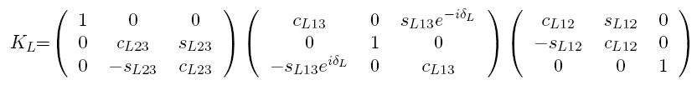
SM Extension with N extra right-handed neutrinos
Boyarski, Ruchayskiy, Shaposhnikov
Yukawa couplings
Matrix (N=3)
Majorana
phases
Mixing

Slide 16
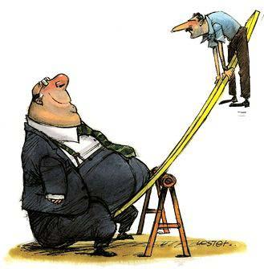
SM Extension with N extra right-handed neutrinos
Majorana masses
to (2 or 3) active
neutrinos via seesaw
Yukawa couplings
Matrix (N=2 or 3 )
NB: Upon Symmetry Breaking
<Φ> = v ≠ 0 → Dirac mass term

Slide 17
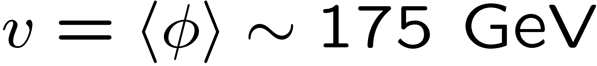
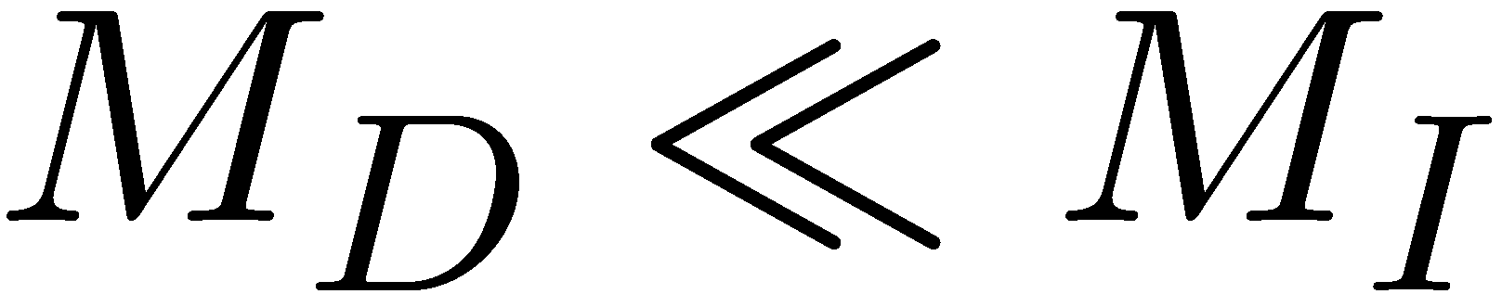
Minkowski,Yanagida,
Mohapatra, Senjanovic
Sechter, Valle …
Light Neutrino Masses through see saw

Slide 18
This talk: fluctuations of
pseudoscalar-induced torsion → dynamical mass M_{I} generation
+ background torsion → matter/antimatter asymmetry
Minkowski,Yanagida,
Mohapatra, Senjanovic
Sechter, Valle …
Light Neutrino Masses through see saw

Slide 19
SM Extension with N extra right-handed neutrinos
From Constraints
(compiled ν oscillation data)
on (light) sterile neutrinos:
Giunti, Hernandez ...
N=1 excluded by data
Yukawa couplings
Matrix (N=2 or 3 )
Model with 2 or 3 singlet fermions works well in reproducing Baryon Asymmetry and is consistent with Experimental Data on neutrino oscillations
Model with N=3 also works fine, and in fact it allows one of the Majorana fermions to almost decouple from the rest of the SM fields, thus providing
candidates for light (keV region of mass) sterile neutrino Dark Matter.

Slide 20

SM Extension with N extra right-handed neutrinos
PERTURBATIVELY CONSISTENT (STABLE)
STANDARD MODEL HIGGS SECTOR
WHEN RIGHT-HANDED NEUTRINOS PRESENT SEEMS TO REQUIRE :
THREE RIGHT-HANDED NEUTRINOS
TWO DEGENERATE IN MASS (HEAVIER THAN GeV)
ONE LIGHT (in keV region) → dark matter candidate
CPT IS ASSUMED AN EXACT SYMMETRY OF THE EARLY UNIVERSE
CP Violation enhanced due to degeneracy
From Constraints
(compiled ν oscillation data)
on (light) sterile neutrinos:
Giunti, Hernandez ...
N=1 excluded by data
Yukawa couplings
Matrix (N=2 or 3 )
Model with 2 or 3 singlet fermions works well in reproducing Baryon Asymmetry and is consistent with Experimental Data on neutrino oscillations
Model with N=3 also works fine, and in fact it allows one of the Majorana fermions to almost decouple from the rest of the SM fields, thus providing
candidates for light (keV region of mass) sterile neutrino Dark Matter.

Slide 21
SM Extension with N extra right-handed neutrinos
Non SUSY
Boyarski, Ruchayskiy, Shaposhnikov
From Constraints
(compiled ν oscillation data)
on (light) sterile neutrinos:
Giunti, Hernandez ...
N=1 excluded by data
Yukawa couplings
Matrix (N=2 or 3 )
Model with 2 or 3 singlet fermions works well in reproducing Baryon Asymmetry and is consistent with Experimental Data on neutrino oscillations
Model with N=3 also works fine, and in fact it allows one of the Majorana fermions to almost decouple from the rest of the SM fields, thus providing
candidates for light (keV region of mass) sterile neutrino Dark Matter.
It can also provide consistent model for Leptogenesis and, through,
sphaleron processes, Baryogenesis.

Slide 22
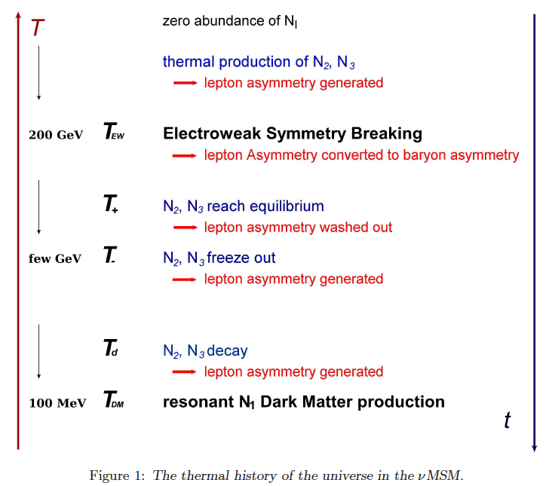
Canetti, Frossart,
Shaposhnikov,
arXiv: 1208.4607

Slide 23
Canetti, Frossart,
Shaposhnikov,
arXiv: 1208.4607

Slide 24
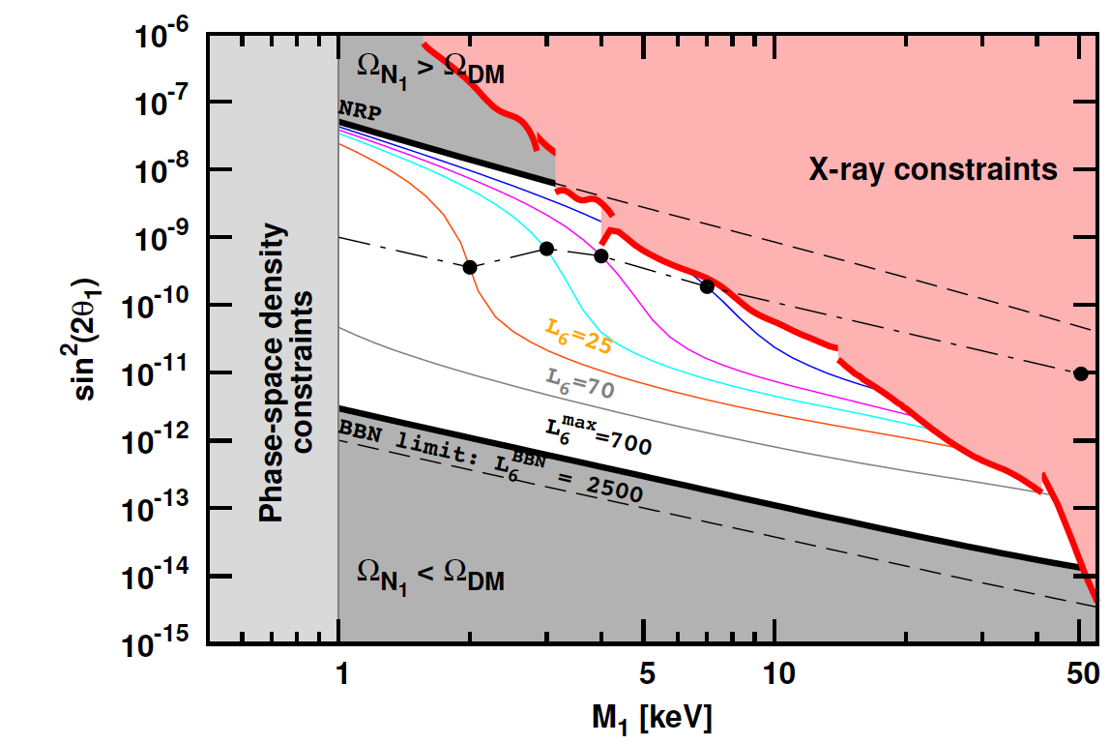
Boyarski, Ruchayskiy, Shaposhnikov…
νMSM
MODEL CONSISTENT WITH BBN, STRUCTURE FORMATION DATA IN THE
UNIVERSE & ALL OTHER ASTROPHYSICAL CONSTRAINTS
M₁ << M₂ ≈ M₃

Slide 25
Boyarski, Ruchayskiy, Shaposhnikov…
νMSM
Decaying N₁ produces narrow spectral line
in spectra of DM dominated astrophysical objects
MODEL CONSISTENT WITH BBN, STRUCTURE FORMATION DATA IN THE
UNIVERSE & ALL OTHER ASTROPHYSICAL CONSTRAINTS
M₁ << M₂ ≈ M₃

Slide 26
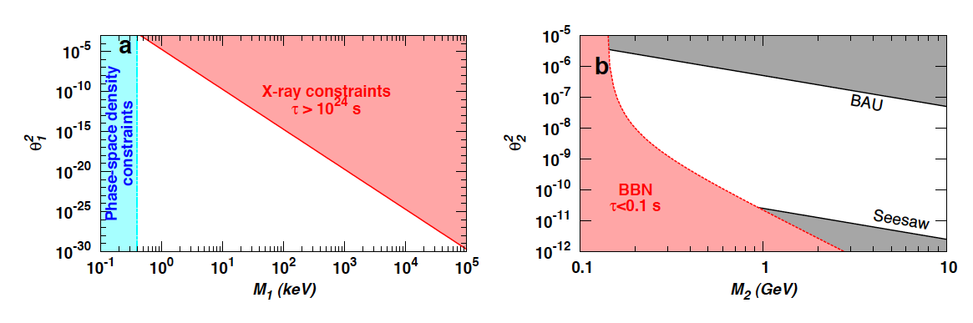

More than one sterile neutrino needed to reproduce Observed oscillations
νMSM
Boyarski, Ruchayskiy, Shaposhnikov…
Constraints on two heavy degenerate singlet neutrinos
N₁ DM production estimation in Early Universe must take into account
its interactions with N_{2,3} heavy neutrinos
M₁ << M₂ ≈ M₃

Slide 27
Important:
PERTURBATIVELY CONSISTENT (STABLE)
STANDARD MODEL HIGGS SECTOR
WHEN RIGHT-HANDED NEUTRINOS PRESENT
SEEMS TO REQUIRE :
THREE RIGHT-HANDED NEUTRINOS
TWO DEGENERATE IN MASS (HEAVIER THAN GeV)
ONE LIGHT (in keV region) → dark matter candidate
CPT IS ASSUMED AN EXACT SYMMETRY OF THE EARLY UNIVERSE
CP Violation enhanced due to degeneracy but
may not be sufficient to reproduce Baryon Asymmetry:

Slide 28
Important:
PERTURBATIVELY CONSISTENT (STABLE)
STANDARD MODEL HIGGS SECTOR
WHEN RIGHT-HANDED NEUTRINOS PRESENT
SEEMS TO REQUIRE :
THREE RIGHT-HANDED NEUTRINOS
TWO DEGENERATE IN MASS (HEAVIER THAN GeV)
ONE LIGHT (in keV region) → dark matter candidate
CPT IS ASSUMED AN EXACT SYMMETRY OF THE EARLY UNIVERSE
CP Violation enhanced due to degeneracy but
may not be sufficient to reproduce Baryon Asymmetry:
Mechanism for baryon asymmetry through coherent
oscillations of degenerate in mass neutrinos
…rather delicate !

Slide 29

Thermal Properties
Ashaka, Shaposhnikov…
If M_{I} < M_{W} (electroweak scale), e.g. M_{I} = O(1) GeV
Keep light neutrino masses in right order , Yukawa couplings must be:
Baryogenesis through coherent
oscillations right-handed singlet fermions
Akhmedov, Rubakov, Smirnov

Slide 30




Higgs mass stability vs higher loops →
Mass degeneracy N_{2,3}
Assume Mass degeneracy N_{2,3} , hence enhanced CP violation
Coherent Oscillations between these singlet fermions
FOR CP VIOLATION TO OCCUR MUST HAVE: Oscillation rate > Hubble rate H(T)
Baryogenesis occurs @:
eg O(100) GeV
Mass N₂ (N₃) / (Mass N₁) = O(10⁵ )
N₁ Lightest Sterile nutrino is a
natural DARK MATTER candidate

Slide 31

BAU ESTIMATES
Assume Mass degeneracy N_{2,3} , hence enhanced CP violation
Coherent Oscillations between these singlet fermions
FOR CP VIOLATION TO OCCUR MUST HAVE: Oscillation rate > Hubble rate H(T)
Baryogenesis occurs @:
eg O(100) GeV
Quite effective Mechanism: Maximal Baryon asymmetry
for T_{B} = T_{sph} = T_{eq}
Assumption: Interactions with plasma of SM particles
do not destroy quantum mechanical coherence of oscillations

Slide 32
BAU ESTIMATES
Assume Mass degeneracy N_{2,3} , hence enhanced CP violation
Coherent Oscillations between these singlet fermions
FOR CP VIOLATION TO OCCUR MUST HAVE: Oscillation rate > Hubble rate H(T)
Baryogenesis occurs @:
eg O(100) GeV
Quite effective Mechanism: Maximal Baryon asymmetry
for T_{B} = T_{sph} = T_{eq}
Assumption: Interactions with plasma of SM particles
do not destroy quantum mechanical coherence of oscillations

Slide 33
CONCLUSIONS FO FAR:
PERTURBATIVELY CONSISTENT (STABLE)
STANDARD MODEL HIGGS SECTOR
WHEN RIGHT-HANDED NEUTRINOS PRESENT
SEEMS TO REQUIRE :
THREE RIGHT-HANDED NEUTRINOS
TWO DEGENERATE IN MASS (HEAVIER THAN GeV)
ONE LIGHT (in keV region) → dark matter candidate
CPT IS ASSUMED AN EXACT SYMMETRY OF THE EARLY UNIVERSE
CP Violation enhanced due to degeneracy but
may not be sufficient to reproduce Baryon Asymmetry
Can we have alternatives to this CP Violation but with the
important role of Right-handed Neutrinos maintained?

Slide 34
PART II
CPT VIOLATION IN
(TORSIONFUL) GEOMETRIES
OF THE
EARLY UNIVERSE
DUE TO KR ``AXIONS’’

Slide 35
CPT VIOLATION IN THE EARLY UNIVERSE
GENERATE Baryon and/or Lepton ASYMMETRY
without Heavy Sterile Neutrinos?
CPT Invariance Theorem :
Flat space-times
Lorentz invariance
Locality
Unitarity
Schwinger, Pauli,
Luders, Jost, Bell
revisited by:
Greenberg,
Chaichian, Dolgov,
Novikov…
(ii)-(iv) Independent reasons for violation

Slide 36
CPT VIOLATION IN THE EARLY UNIVERSE
GENERATE Baryon and/or Lepton ASYMMETRY
without Heavy Sterile Neutrinos?
CPT Invariance Theorem :
Flat space-times
Lorentz invariance
Locality
Unitarity
Schwinger, Pauli,
Luders, Jost, Bell
revisited by:
Greenberg,
Chaichian, Dolgov,
Novikov…
Background
induced
(ii)-(iv) Independent reasons for violation

Slide 37
GRAVITATIONAL BACKGROUNDS
GENERATING CPT VIOLATING EFFECTS
IN THE EARLY UNIVERSE:
PARTICLE-ANTIPARTICLE DIFFERENCES
IN DISPERSION RELATIONS →
Differences in populations
freeze out → Baryogenesis or
→ Leptogenesis → Baryogenesis

Slide 38
GRAVITATIONAL BACKGROUNDS
GENERATING CPT VIOLATING EFFECTS
IN THE EARLY UNIVERSE:
PARTICLE-ANTIPARTICLE DIFFERENCES
IN DISPERSION RELATIONS →
Differences in populations
freeze out → Baryogenesis or
→ Leptogenesis → Baryogenesis
REVIEW VARIOUS SCENARIOS

Slide 39
GRAVITATIONAL BACKGROUNDS
GENERATING CPT VIOLATING EFFECTS
IN THE EARLY UNIVERSE:
PARTICLE-ANTIPARTICLE DIFFERENCES
IN DISPERSION RELATIONS →
Differences in populations
freeze out → Baryogenesis or
→ Leptogenesis → Baryogenesis
REVIEW VARIOUS SCENARIOS
B-L conserving GUT
or
Sphaleron

Slide 40
CPTV Effects of different Space-Time-Curvature/Spin couplings between neutrinos/antineutrinos
B. Mukhopadhyay, U. Debnath, N. Dadhich, M. Sinha
Lambiase, Mohanty
Curvature Coupling to fermion spin may lead to different dispersion relations
between neutrinos and antineutrinos (assumed dominant in the Early eras)
in non-spherically symmetric geometries in the Early Universe.

Slide 41

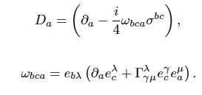



Dirac Lagrangian
Gravitational covariant derivative
including spin connection

Slide 42

Dirac Lagrangian (for concreteness, it can be extended to Majorana neutrinos)
Gravitational covariant derivative
including spin connection

Slide 43
Dirac Lagrangian (for concreteness, it can be extended to Majorana neutrinos)
Gravitational covariant derivative
including spin connection

Slide 44

Dirac Lagrangian (for concreteness, it can be extended to Majorana neutrinos)
Gravitational covariant derivative
including spin connection
Standard Model Extension
type Lorentz-violating
coupling
(Kostelecky et al.)

Slide 45
Dirac Lagrangian (for concreteness, it can be extended to Majorana neutrinos)
Gravitational covariant derivative
including spin connection
For homogeneous and isotropic
Friedman-Robertson-Walker
geometries the resulting B^{μ} vanish

Slide 46
Dirac Lagrangian (for concreteness, it can be extended to Majorana neutrinos)
Gravitational covariant derivative
including spin connection
Can be constant in a given
local frame in Early Universe
axisymmetric (Bianchi) cosmologies
or near rotating Black holes

Slide 47

DISPERSION RELATIONS OF NEUTRINOS ARE DIFFERENT
FROM THOSE OF ANTINEUTRINOS IN SUCH GEOMETRIES
IF Bª = CONSTANT IN A LOCAL FRAME
± refers to chiral fields (here neutrino/antineutrino)
CPTV Dispersion relations
_
but (bare) masses are equal between particle/anti-particle sectors
Abundances of neutrinos in Early Universe, then, different from those of antineutrinos
if B₀ is non-trivial, ALREADY IN THERMAL EQUILIBRIUM

Slide 48




Abundances of neutrinos in Early Universe different from those of antineutrinos
if B⁰ ≠ 0 asnd constant in a local frame

Slide 49

DISPERSION RELATIONS OF NEUTRINOS ARE DIFFERENT
FROM THOSE OF ANTINEUTRINOS IN SUCH GEOMETRIES
IF Bª = CONSTANT IN A LOCAL FRAME
± refers to chiral fields (here neutrino/antineutrino)
CPTV Dispersion relations
_
but (bare) masses are equal between particle/anti-particle sectors
Abundances of neutrinos in Early Universe, then, different from those of antineutrinos
if B₀ is non-trivial, ALREADY IN THERMAL EQUILIBRIUM
Lepton Asymmetry, e.g. for neutrinos
CPTV BARYOGENESIS through B-L conserving sphalerons? NO NEED FOR
ENHANCED CP VIOLATION IN EARLY UNVIERSE?

Slide 50

Fermions in Gravity with TORSION
NEM & Sarben Sarkar, arXiv:1211.0968
Ellis, NEM, Sarkar 1304.5433
A SPECIFIC KIND OF TORSION (KALB-RAMOND FIELD STRENGTH)
INSPIRED FROM STRING THEORY (UV COMPLETE)
CAN DO THE JOB OF PROVIDING A CONSTANT B⁰
AXIAL BACKGROUND IN A LOCAL FRAME OF FRW COSMOLOGY

Slide 51
Fermions in Gravity with TORSION
Dirac Lagrangian (for concreteness, it can be extended to Majorana neutrinos)
Gravitational covariant derivative
including spin connection
If torsion then Γ_{μν} ≠ Γ_{νμ}
antisymmetric part is the
contorsion tensor, contributes to
vielbeins (tetrads)
independent from
spin connection ω_{μ}^{ab}
now ….
of interest to us here….cf below

Slide 52
Field Theories with (Kalb-Ramond) torsion & axion fields : String inspired models, loop quantum gravity effective field theories …
Majorana Neutrino Masses from (three-loop) anomalous terms with axion-neutrino couplings
UV complete models

Slide 53
Microscopic UV complete underlying theory of quantum gravity :
STRINGS
Massless Gravitational multiplet of (closed) strings: spin 0 scalar (dilaton)
spin 2 traceless symmetric rank 2
tensor (graviton)
spin 1 antisymmetric rank 2 tensor
KALB-RAMOND FIELD
Effective field theories (low energy scale E << M_{s}) `` gauge’’ invariant
Depend only on field strength :
Bianchi identity :

Slide 54
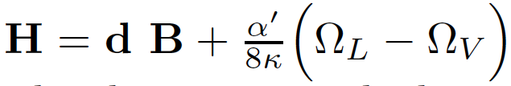

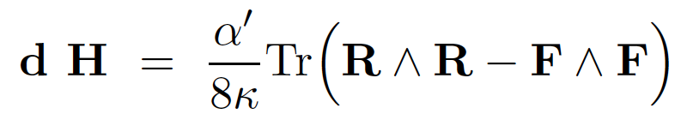
Anomaly (gravitational vs gauge) cancellation in strings require redefinition of H
so that Bianchi identity now is extended to :
Lorentz (L) & Gauge (V)
Chern-Simons three forms
EXTENDED BIANCHI IDENTITY

Slide 55
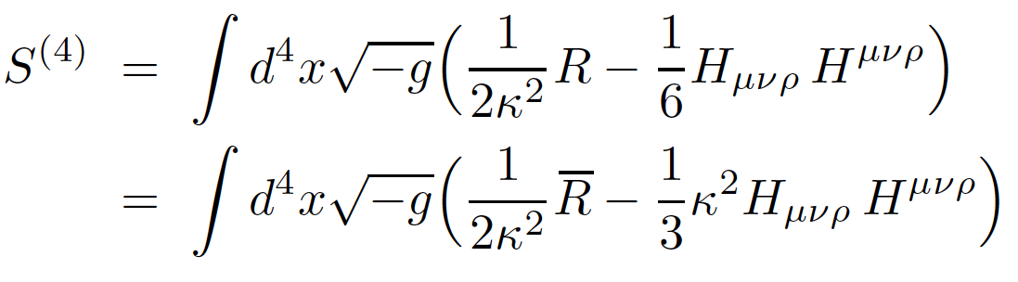


ROLE OF Kalb-Ramond H-FIELD AS TORSION
EFFECTIVE GRAVITATIONAL ACTION IN STRING LOW-ENERGY LIMIT CAN BE
EXPRESSED IN TERMS OF A GENERALIZED CURVATURE RIEMANN TENSOR
WHERE THE CHRISTOFFEL CONNECTION INCLUDES H-FIELD TORSION
4-DIM
PART
IN 4-DIM DEFINE DUAL OF H AS :
b(x) = Pseudoscalar
(Kalb-Ramond (KR) axion)

Slide 56



FERMIONS COUPLE TO H –TORSION VIA GRAVITATIONAL COVARIANT DERIVATIVE
TORSIONFUL CONNECTION, FIRST-ORDER FORMALISM
gauge field
contorsion
Non-trivial contributions to B^{μ}

Slide 57
FERMIONS COUPLE TO H –TORSION VIA GRAVITATIONAL COVARIANT DERIVATIVE
TORSIONFUL CONNECTION, FIRST-ORDER FORMALISM
gauge field
contorsion
Non-trivial contributions to B^{μ}
Constant H ?

Slide 58



Exact (conformal Field Theories on World-sheet) Solutions from String theory
Antoniadis, Bachas, Ellis, Nanopoulos
Cosmological Solutions, non-trivial time-dependent dilatons, axions
In Einstein frame E (Scalar curvature term in gravitational effective action
has canonical normalisation):
Central charge of uderlying world-sheet conformal field theory
Kac-Moody
algebra level
``internal’’ dims
central charge

Slide 59
Exact (conformal Field Theories on World-sheet) Solutions from String theory
Antoniadis, Bachas, Ellis, Nanopoulos
Cosmological Solutions, non-trivial time-dependent dilatons, axions
In Einstein frame E (Scalar curvature term in gravitational effective action
has canonical normalisation):
Central charge of uderlying world-sheet conformal field theory
Kac-Moody
algebra level
``internal’’ dims
central charge

Slide 60
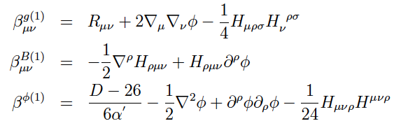
Conformal Invariance (world-sheet) Conditions for the string to O(α’)
(lowest non-trivial order in derivatives in the effective target-space action):
= 0
= 0
= 0
Linear dilaton solution in string frame (or logarithmic in FRW time
in Einstein-frame with conformally flat Einstein-frame target space time
→ exact (to all orders in α’)

Slide 61
Exact (conformal Field Theories on World-sheet) Solutions from String theory
Antoniadis, Bachas, Ellis, Nanopoulos
Cosmological Solutions, non-trivial time-dependent dilatons, axions
In Einstein frame E (Scalar curvature term in gravitational effective action
has canonical normalisation):
Central charge of uderlying world-sheet conformal field theory
Kac-Moody
algebra level
``internal’’ dims
central charge

Slide 62



NEM & Sarben Sarkar, arXiv:1211.0968
H-torsion & CPTV
Covariant Torsion tensor
Constant
constant B⁰
Lepton Asymmetry as in previous cases , e.g. for neutrinos

Slide 63
DISPERSION RELATIONS OF NEUTRINOS ARE DIFFERENT
FROM THOSE OF ANTINEUTRINOS IN SUCH GEOMETRIES
± refers to chiral fields (here neutrino/antineutrino)
CPTV Dispersion relations
but (bare) masses are equal between particle/anti-particle sectors
Abundances of neutrinos in Early Universe, then, different from those of antineutrinos
if B₀ is non-trivial, ALREADY IN THERMAL EQUILIBRIUM
Lepton Asymmetry, e.g. for neutrinos
CPTV BARYOGENESIS through B-L conserving sphalerons? NO NEED FOR
ENHANCED CP VIOLATION IN EARLY UNVIERSE?

Slide 64






CPTV → neutrino/antineutrino mixing & oscillations
M Sinha & B. Mukhopadhyay
arXiv: 0704.2593
Assume Majorana neutrino in Weyl rep (Lepton number violation unavoidable)
Majorana mass term
violates L number

Slide 65
CPTV → neutrino/antineutrino mixing & oscillations
M Sinha & B. Mukhopadhyay
arXiv: 0704.2593
Assume Majorana neutrino in Weyl rep (Lepton number violation unavoidable)
Lead to
neutrino/antineutrino
mixing & oscillations

Slide 66
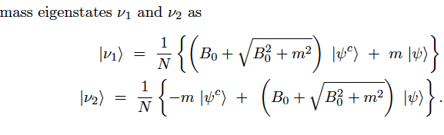




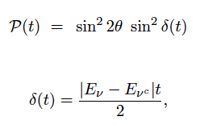

NB: neutrino CPTV mass shifts
neutrino/antineutrino mixing
oscillations

Slide 67

NB: neutrino CPTV mass shifts
neutrino/antineutrino mixing
oscillations
oscilaltion length

Slide 68


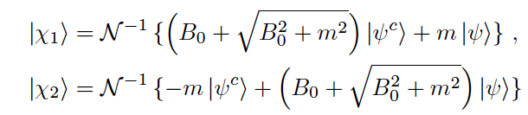


Ellis, NEM, Sarkar 1304.5433
SCENARIO: Phase transitions in the early string Universe may induce
B⁰ = 0 @ T = T_{d}
T > T_{d} : B⁰ ≠ 0 ➔
Majorana Neutrino-Antineutrino Oscillations (Pontecorvo-type)
4-component
chiral Majorana
spinor
Mass eigenstates
with eigenvalues

Slide 69
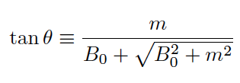
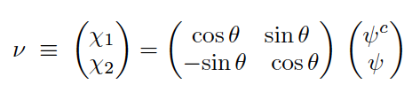




Neutrino/antineutrino Mixing & Oscillations
Number operators
≠ 0 for
Probability of Oscillation
Oscillation length

Slide 70

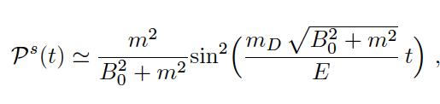


Neutrino/Antineutrino oscillations are the local processes
in the early Universe responsible for the CPT Violation
They occur provided the oscillation length is smaller than the Hubble horizon
For T_{d} = O(10⁹ GeV) the Hubble horizon size is 10⁻¹² cm & for B₀ = O(0.1) GeV
the oscillation length is 10⁻¹³ cm, i.e. smaller than Hubble Horizon, so
oscilaltions can occur → provide chemical equilibrium for T > T_{d}
NB: If neutrinos have also Dirac mass, i.e. mass matrix in lagrangian of the form
with oscillation length depending
on the neutrino energy E

Slide 71

Neutrino/natineutrino oscillation processes are UNIQUE
to Majorana neutrinos
Charged leptons and quarks of the Standard Model,
which also couple to H-torsion, cannot exhibit such oscillation
due to electric charge conservation
Hence: above scenario for Leptogenesis @ T = 10⁹ GeV
and then Baryogenesis at T = O(100 GeV)
through standard-model B-L conserving sphaleron processes
appears unique to Majorana Neutrinos
Consistent with absence
of observed CPTV
today in neutrino sector
Torsion B⁰ = 0
(or very small) today

Slide 72
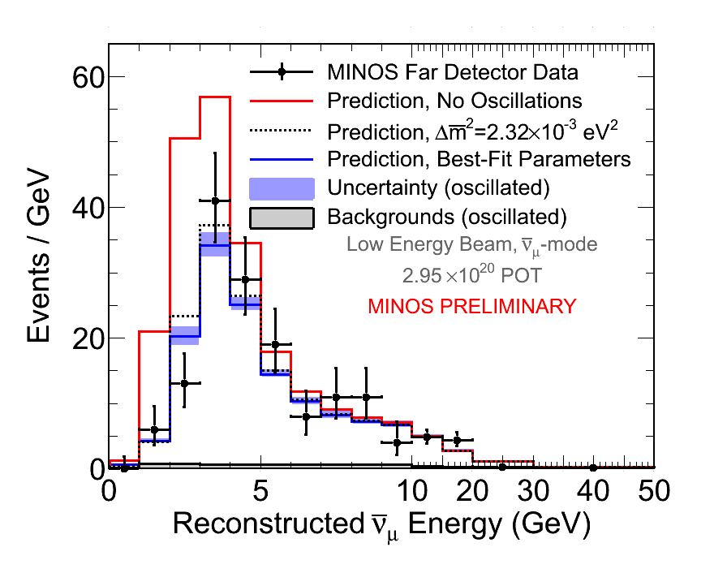
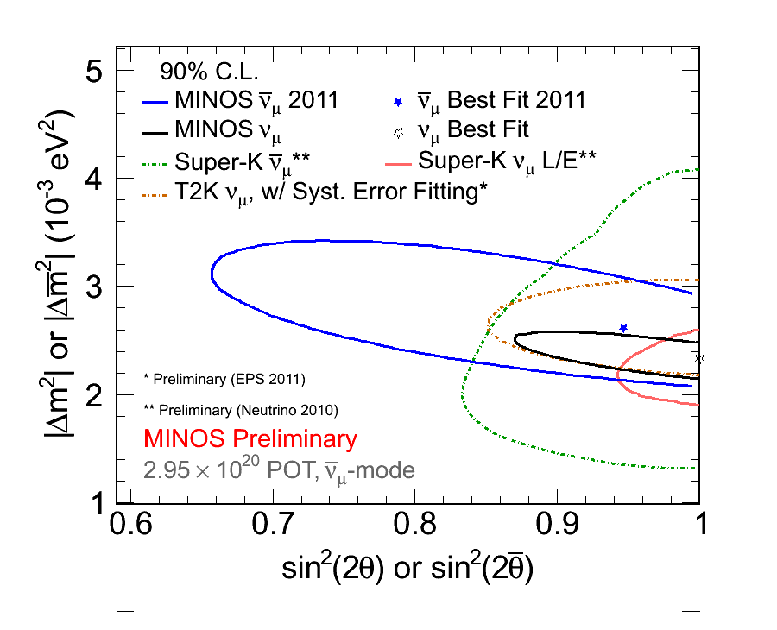
MINOS Exp. RESULTS ON Potential Neutrino-Antineutrino
OSCILLATION PARAMETER DIFFERENCES
http://www-numi.fnal.gov
−
−
v_{μ} disapearance-Energy spectrum
v_{μ} vs v_{μ} Oscillation parameters
[arXiv:1108.1509]
[arXiv:1104.0344]
[arXiv1103.0340]
−
−
ν_{μ} disappearance:
Δm²=(2.62+0.31-0.28 (stat.) ±0.09 (syst.) )x10⁻³ eV²,
sin²(2Θ)=0.95 +0.10-0.11 (stat.) ±0.01 (syst.).
ν_{μ} disappearance: Δm²=(2.32+0.12-0.08)x10⁻³ eV² , sin²(2Θ) =1.00 (sin²(2Θ) > 0.90 @ 90% CL
Consistent with equality of mass differences between particle/antiparticles

Slide 73
MINOS Exp. RESULTS ON Potential Neutrino-Antineutrino
OSCILLATION PARAMETER DIFFERENCES
http://www-numi.fnal.gov
NO OBSERVED CPTV TODAY
−
−
v_{μ} disapearance-Energy spectrum
v_{μ} vs v_{μ} Oscillation parameters
[arXiv:1108.1509]
[arXiv:1104.0344]
[arXiv1103.0340]
−
−
ν_{μ} disappearance:
Δm²=(2.62+0.31-0.28 (stat.) ±0.09 (syst.) )x10⁻³ eV²,
sin²(2Θ)=0.95 +0.10-0.11 (stat.) ±0.01 (syst.).
ν_{μ} disappearance: Δm²=(2.32+0.12-0.08)x10⁻³ eV² , sin²(2Θ) =1.00 (sin²(2Θ) > 0.90 @ 90% CL
Consistent with equality of mass differences between particle/antiparticles

Slide 74


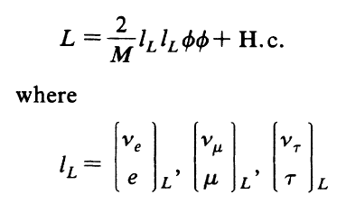
Independent of
Initial Conditions
@ T >>T_{eq}
Standard Thermal Leptogenesis
Heavy Right-handed Majorana neutrinos enter equilibrium at T = T_{eq} > T_{decay}
Lepton number
Violation
Out of Equilibrium Decays
enhanced CP V
Produce Lepton asymmetry
Equilibrated electroweak
B+L violating sphaleron interactions
Fukugita, Yanagida,
Independent of Initial Conditions
Kuzmin, Rubakov,
Shaposhinkov
Observed Baryon Asymmetry
In the Universe (BAU)
Estimate BAU by solving Boltzmann equations
for Heavy Neutrino Abundances

Slide 75
Independent of
Initial Conditions
@ T >>T_{eq}
Standard Thermal Leptogenesis
X
Heavy Right-handed Majorana neutrinos enter equilibrium at T = T_{eq} > T_{decay}
Lepton number
Violation
Out of Equilibrium Decays
enhanced CP V
Produce Lepton asymmetry
Equilibrated electroweak
B+L violating sphaleron interactions
Fukugita, Yanagida,
Independent of Initial Conditions
Kuzmin, Rubakov,
Shaposhinkov
Observed Baryon Asymmetry
In the Universe (BAU)
Estimate BAU by solving Boltzmann equations
for Heavy Neutrino Abundances

Slide 76
CPT Violating Thermal Leptogenesis
Ellis, NEM, Sarkar
1304.5433
Early Universe
T > T_{d} = 10⁹ GeV
CPT Violation
No need for enhanced CPV. Heavy Right-handed
Majorana neutrino/antineutrino oscillations
particle/antiparticle
populations difference
already in thermal
equilibrium
KR axion →
torsion B⁰ vector
Produce Lepton asymmetry
Equilibrated electroweak
B+L violating sphaleron interactions
T = O(100) GeV
Fukugita, Yanagida,
Independent of Initial Conditions
Kuzmin, Rubakov,
Shaposhinkov
Observed Baryon Asymmetry
In the Universe (BAU)
Estimate BAU by fixing CPTV background parameters
In some models this may imply fine tuning ….

Slide 77
B⁰ : (string) theory underwent a phase transition
@ T = T_{d} = 10⁹ GeV, to :
(i) either B⁰ = 0
(ii) or B⁰ small today but non zero

Slide 78
If a small Bª is
present today
Standard Model Extension type coupling b_{μ}
Kostelecky, Mewes, Russell, Lehnert …

Slide 79
If a small Bª is
present today
Standard Model Extension type coupling b_{μ}
Kostelecky, Mewes, Russell, Lehnert …

Slide 80
If a small Bª is
present today
Standard Model Extension type coupling b_{μ}
Kostelecky, Mewes, Russell, Lehnert …
If due to H-torsion, it should couple universally (gravity)
to all particle species of the standard model (electrons etc)

Slide 81
If a small Bª is
present today
Standard Model Extension type coupling b_{μ}
Kostelecky, Mewes, Russell, Lehnert …
If due to H-torsion, it should couple universally (gravity)
to all particle species of the standard model (electrons etc)
Very Stringent constraints from astrophysics on spatial ONLY components (e.g. Masers)

Slide 82
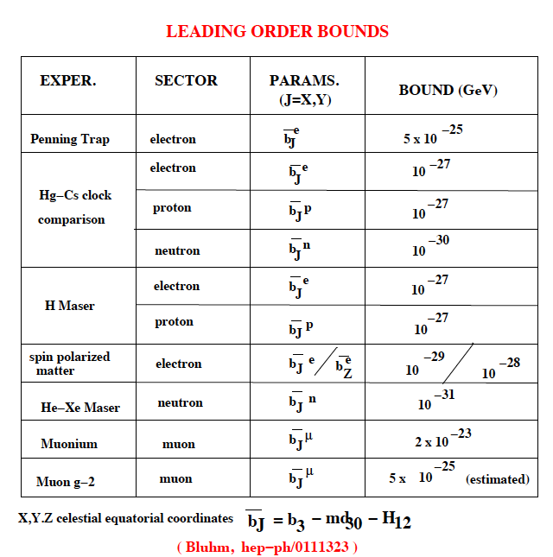
b_{μ} = Β_{μ}
NB

Slide 83
If a small Bª is
present today
Standard Model Extension type coupling b_{μ}
Kostelecky, Mewes, Russell, Lehnert …
If due to H-torsion, it should couple universally (gravity)
to all particle species of the standard model (electrons etc)
Very Stringent constraints from astrophysics on spatial ONLY components (e.g. Masers)
+ STRINGENT CONSTRAINTS TODAY
DUE TO NON-OBSERVATION OF
NEUTRINO/ANTINEUTRINO OSCILLATIONS?

Slide 84
PART III:
QUANTUM
H-TORSION-INDUCED
MASS HIERARCHY
FOR RIGHT-HANDED
NEUTRINO

Slide 85
ABOVE: We have seen how a background of
kalb-Ramond H-Torsion generates
Matter-Antimatter Asymmetry via
(Right-handed) neutrino/antineutrino oscillations
in the Early Universe

Slide 86
ABOVE: We have seen how a background of
kalb-Ramond H-Torsion generates
Matter-Antimatter Asymmetry via
(Right-handed) neutrino/antineutrino oscillations
in the Early Universe
What About the Quantum Fluctuations of the H-torsion ?
Physical Effect in Generating Majorana masses for neutrinos
via coupling to ordinary axion fields

Slide 87


ANOMALOUS GENERATION
OF RIGHT-HANDED MAJORANA
NEUTRINO MASSES THROUGH
TORSIONFUL QUANTUM GRAVITY
UV complete string models ?
NEM & Pilaftsis 2012
PRD 86, 124038
arXiv:1209.6387

Slide 88


Fermionic Field Theories with H-Torsion
EFFECTIVE ACTION AFTER INTEGRATING OUT
QUANTUM TORSION FLUCTUATIONS
Fermions:
+ standard Dirac terms without torsion
conserved
``torsion ‘’ charge
Bianchi identity
classical
Postulate conservation at quantum level by adding counterterms
Implement via constraint
→ lagrange multiplier in Path integral → b-field

Slide 89
Fermionic Field Theories with H-Torsion
EFFECTIVE ACTION AFTER INTEGRATING OUT
QUANTUM TORSION FLUCTUATIONS
Fermions:
+ standard Dirac terms without torsion
conserved
``torsion ‘’ charge
Bianchi identity
classical
Postulate conservation at quantum level by adding counterterms
Implement via constraint
→ lagrange multiplier in Path integral → b-field

Slide 90
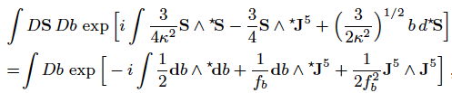


Slide 91
partial integrate

Slide 92


partial integrate
Use chiral anomaly equation (one-loop) in curved space-time:
Hence, effective action of torsion-full QED

Slide 93
partial integrate
Use chiral anomaly equation (one-loop) in curved space-time:
coupling
Hence, effective action of torsion-full QED

Slide 94
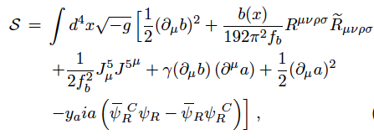
Fermionic Field Theories with H-Torsion
EFFECTIVE ACTION AFTER INTEGRATING OUT
QUANTUM TORSION FLUCTUATIONS
+
+ Standard Model terms for fermions
SHIFT SYMMETRY b(x) → b(x) + c
total derivatives

Slide 95
Mavromatos, Pilaftsis arXiv: 1209.6387
ANOMALOUS MAJORANA NEUTRINO MASS TERMS
from QUANTUM TORSION
SHIFT SYMMETRY b(x) → b(x) + c
total derivatives
OUR SCENARIO Break such shift symmetry by coupling first b(x) to another
pseudoscalar field such as QCD axion a(x) (or e.g. other string axions)

Slide 96
Mavromatos, Pilaftsis arXiv: 1209.6387
ANOMALOUS MAJORANA NEUTRINO MASS TERMS
from QUANTUM TORSION
SHIFT SYMMETRY b(x) → b(x) + c
total derivatives
OUR SCENARIO Break such shift symmetry by coupling first b(x) to another
pseudoscalar field such as QCD axion a(x) (or e.g. other string axions)
Yukawa
neutrino fields

Slide 97

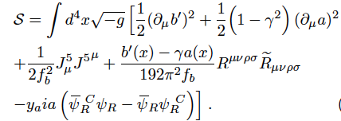

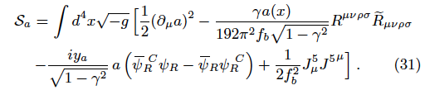
Field redefinition
so, effective action becomes
must have otherwise axion field a(x) appears as a ghost → canonically
normalised kinetic terms

Slide 98
Field redefinition
so, effective action becomes
must have otherwise axion field a(x) appears as a ghost → canonically
normalised kinetic terms
CHIRALITY CHANGE

Slide 99
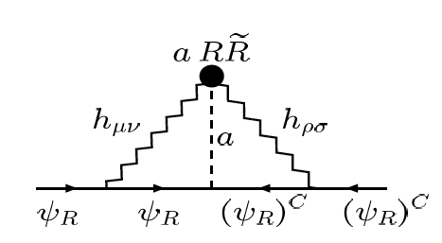
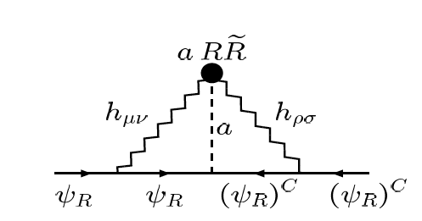
NEM, Pilaftsis arXiv: 1209.6387
b
a = axion
mixing with KR
field b
GRAVITON
b
x
axion field redefinition

Slide 100
THREE-LOOP ANOMALOUS FERMION MASS TERMS
ONE-LOOP
GRAVITON
AXION
GRAVITON
CHIRALITY CHANGE

Slide 101

THREE-LOOP ANOMALOUS FERMION MASS TERMS
ONE-LOOP
GRAVITON
AXION
GRAVITON
CHIRALITY CHANGE
Λ = UV cutoff

Slide 102

SOME NUMBERS

Slide 103

SOME NUMBERS
INTERESTING
WARM DARK MATTER
REGIME
Appropriate Hierarchy for the other two massive
Right-handed neutrinos for Leptogenesis-Baryogenesis
& Dark matter cosntraints can be arranged
by choosing Yukawa couplings

Slide 104
Boyarski, Ruchayskiy, Shaposhnikov…
νMSM
MODEL CONSISTENT WITH BBN, STRUCTURE FORMATION DATA IN THE
UNIVERSE & ALL OTHER ASTROPHYSICAL CONSTRAINTS

Slide 105
More than one sterile neutrino needed to reproduce Observed oscillations
νMSM
Boyarski, Ruchayskiy, Shaposhnikov…
Constraints on two heavy degenerate singlet neutrinos
N₁ DM production estimation in Early Universe must take into account
its interactions with N_{2,3} heavy neutrinos

Slide 106





FINITENESS OF THE MASS
MULTI-AXION SCENARIOS (e.g. string axiverse)
positive mass spectrum
for all axions
simplifying all mixing equals

Slide 107
FINITENESS OF THE MASS
MULTI-AXION SCENARIOS (e.g. string axiverse)
positive mass spectrum
for all axions
simplifying all mixing equals
M_{R} : UV finite for n=3 @ 2-loop independent of axion mass

Slide 108

CONCLUSIONS
nuMSM: Three Sterile neutrinos necessary for Higgs sector stability ?
These Sterile Neutrinos may explain matter-antimatter origin in the Universe
Lightest of them provide interesting Dark matter Candidates
Gravitationally-induced anomalous Right-handed Majorana neutrino masses possible, without the need for see-saw…
Interesting Physics for the Early Universe to be investigated, e.g. H-torsion-induced CPTV Leptogenesis/Baryogenesis

Slide 109
OUTLOOK
keV dark matter (generic) may play important role in galactic structures (core & haloes)
Right-handed neutrino matter with scalar and/or vector interactions may provide consistent galactic profiles for haloes and core structure → core contains significant amounts of right-
handed neutrinos (rhn)
role of rhn condensates?
(Ruffini, Arguelles, Rueda,…NEM)
ASTROPHYSICS

Slide 110
FURTHER OUTLOOK
Scalar Fields in Early Universe: Plenty of them in extended
particle physics models:
inflaton(s), dilaton, axions,
moduli ….Various effects…
In stringy model our model:
Linear in cosmic time background KR pseudoscalar : b ~ t
b-induced torsion that produces matter/antimatter asymmetry
Logarithmic dilaton φ ~ Ln a(t) = Ln (t) →
→ linearly expanding Universe

Slide 111


FURTHER OUTLOOK
Scalar Fields in Early Universe: Plenty of them in extended
particle physics models:
inflaton(s), dilaton, axions,
moduli ….Various effects…
PERSONAL PERSPECTIVE
Running dilaton
Dilution of dark matter
relic density due to coupling
with running dilatons
Lahanas, NEM, Nanopoulos,
Bender, Sarkar

Slide 112
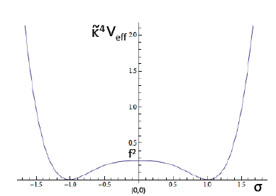
FURTHER OUTLOOK
Scalar Fields in Early Universe: Plenty of them in extended
particle physics models:
inflaton(s), dilaton, axions,
moduli ….Various effects…
PERSONAL PERSPECTIVE
Inflation in the model
Condensation of gravitino fields →
dynamical SUGRA BREAKING
inflation : small-field inflation
due to flat one-loop effective potential
of gravitino condensate (σ = inflaton)
Ellis, NEM,
Alexandre, Houston

Slide 113
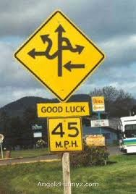

IS THIS CPTV ROUTE WORTH FOLLOWING? ….
CPT Violation
Construct Microscopic Early Universe or Quantum Gravity
models with strong CPT Violation in Early Universe eras, but
maybe weak today… Fit with all available data…
Estimate in this way matter-antimatter asymmetry in Universe.

Slide 114

SPARES

Slide 115
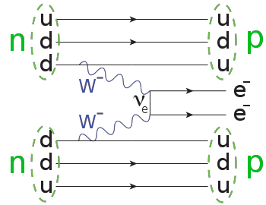

M Sinha & B. Mukhopadhyay
arXiv: 0704.2593
Modifications in Neutrinoless 2Beta
decay rate in 2 flavour mixing
(due to CPTV modified effective mass)
Majorana neutrino
If a small B⁰ is
present today
ignore neutrino/
antineutrino
mixing here:
Amplitude

Slide 116



If a small Bª is
present today
Sinha, Mukhopadhyay, 0704.2593
…will also affect flavour oscillations
2-flavour toy example
neutrino-antineutrino mixing on top of flavour mixing

Slide 117


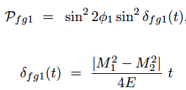






FLAVOUR OSCILALTIONS IN THE PRESENCE OF GRAVITY
2 SETS OF FLAVOUR EIGENSTATES
OSCILLATION
LENGTH

Slide 118
FLAVOUR OSCILALTIONS IN THE PRESENCE OF GRAVITY
2 SETS OF FLAVOUR EIGENSTATES
STRINGENT CONSTRAINTS TODAY
DUE TO NON-OBSERVATION OF
NEUTRINO/ANTINEUTRINO OSCILLATIONS?
OSCILLATION
LENGTH

Slide 119
NB:Some Remarks
on Right-Handed
Neutrinos & CMB

Slide 122
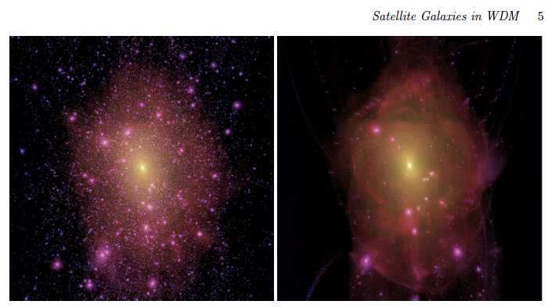
Further Evidence in fvour of Warm Dark Matter
& Structure Formation
Warm Dark Matter (WDM) Universe may solve puzzle of Satelite Galaxies
to Milky Way whose properties are incompatible with Cold Dark Matter (CDM) Model :
Satelite internal dynamics and structure formation inexplicable by CDM
Lovell, Eke, Frenk et al., arXiv: 1104.2929

Slide 124
PLANCK
PLANCK + BAO

Slide 125
PLANCK SATELLITE RESULTS ON STERILE NEUTRINOS
Effective number of excited neutrino species contributing to
radiation content of the Universe as measured by CMB data within ΛCDM
PLANCK + WMAP+ BAO +
high-multiple CMB data
@ 68 % C.L.
still leaves room for almost an extra
light neutrino species?
May be, with active-sterile mass
squared splitting in the range
Δm²_{i4} = (10⁻⁵ – 10² ) eV² and
active/sterile mixing sin²θ_{i4} < 10^{-2.5}
Mirizzi et al. 1303.5368

Slide 126



de Vega, Sanchez, 1304.0759
BUT…Subtle connection of N_{eff} to real number of active plus keV sterile neutrinos
One warm (keV) dark matter sterile neutrino contributes to N_{eff} at recombination (rc)
(entropy conservation requirements)
@ z=1094 (redshift of rc), one can estimate for, e.g. standard model
too small to be detected by CMB
Since (see previous slide) one sterile (Majorana) neutrino up to a few eV mass
range is compatible with Planck → important, since, in view of the above,
this may imply also the existence of keV sterile neutrinos
playing the role of dark matter → as in the νMSM extension of Standard Model

